Slide 1

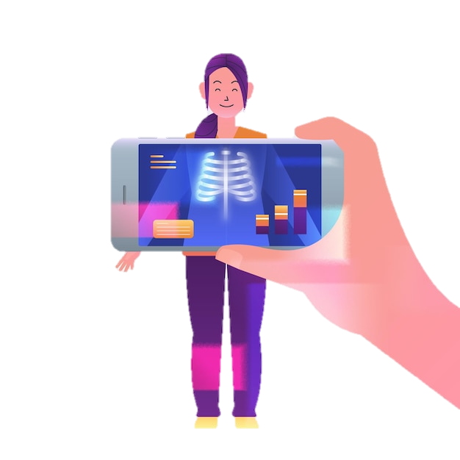
CNN Model for Chest X-ray Classification
Ayah Mohammad Abu Thib
Amjad Abderrahmane
Supervisor: Hussain Salih

Slide 2
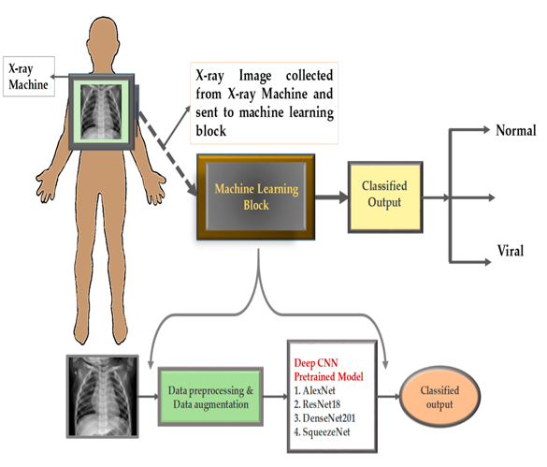

Context:
Automated Diagnosis of COVID-19 from Chest X-ray Images
Importance of diagnosing COVID-19 in a timely and accurate manner.
Human resource crisis during the pandemic.
COVID-19

Slide 3

Using CNN for Image Classification
CNNs are well-suited for image classification tasks due to their ability to automatically learn hierarchical features, exploit spatial relationships, and generalize well to unseen data.
Their architecture is inspired by the organization of the visual cortex in the human brain, making them effective tools for processing and understanding visual information.

Slide 4
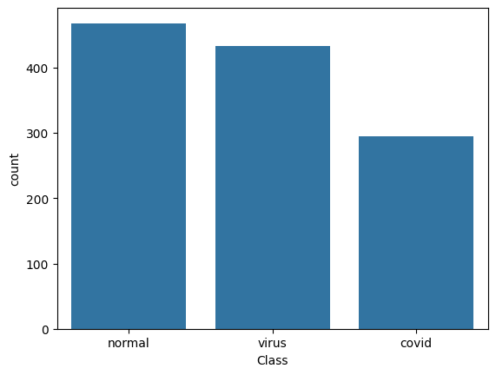
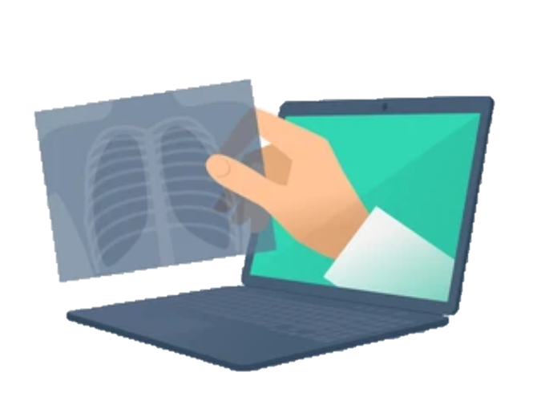
Dataset Description:
We have 1196 images representing 3 classes : Normal, Virus and Covid
Normal: 468 images
Virus: 433 images
Covid : 295 images

Slide 5
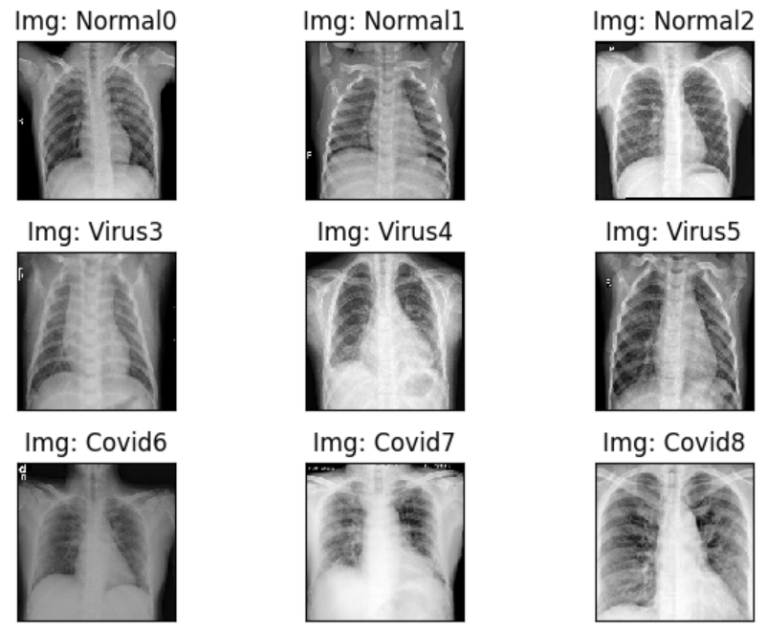
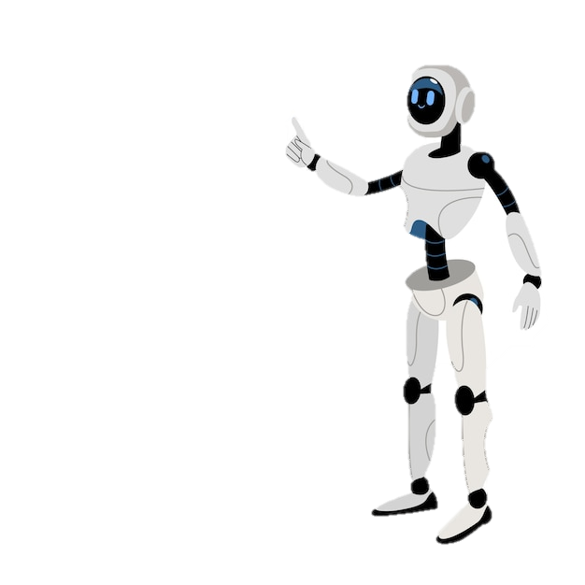
Data Visualization:

Slide 6
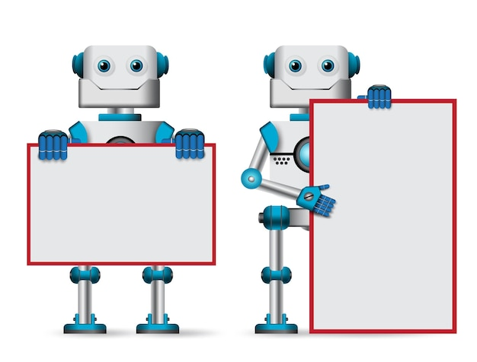
Preprocessing
Resizing image shapes
Converting Labels using One-Hot-Encoder
(0,0,1) → Virus
(0,1,0) → Normal
(1,0,0) → Covid
Normalizing pixel values
1592 X 1448
2169 X 1852
1837 X 1505
1166 X 1161
1904 X 1474
1992 X 1285
………..
150 X 150

Slide 7
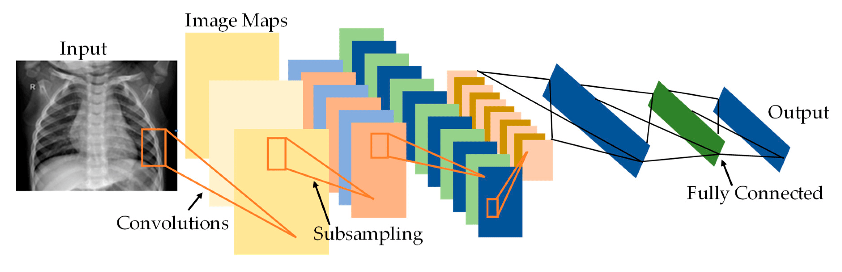
Used Techniques:
CNN.
Batch Normalization.
Flatten Layer.
Dropout.
Fully Connected Layers.

Slide 8
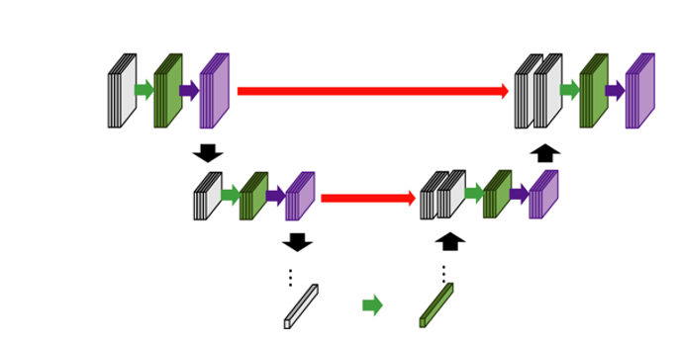
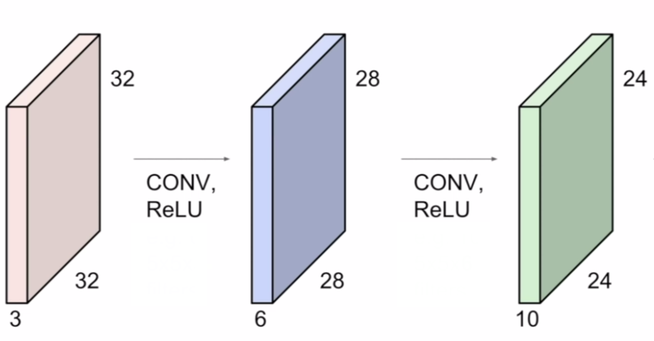
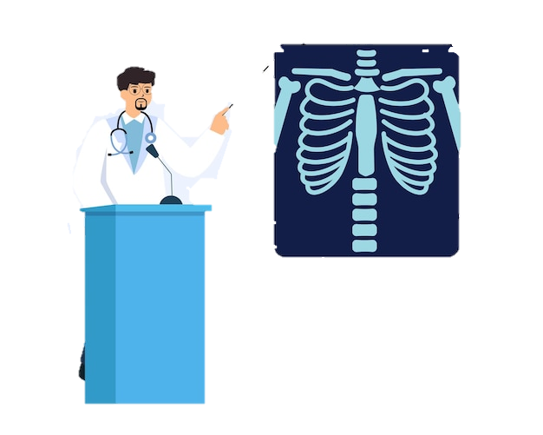
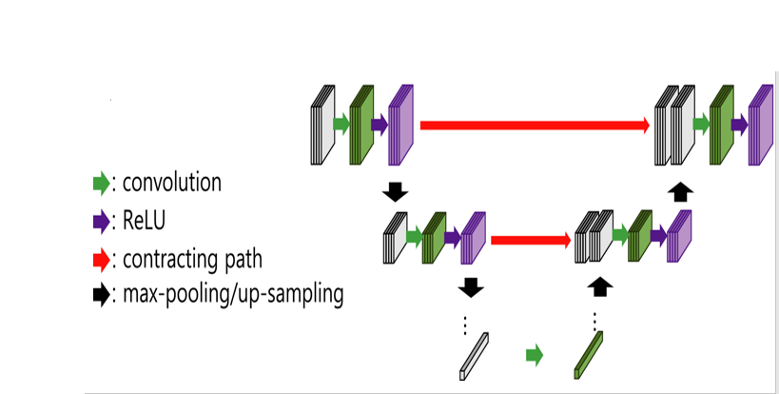
Convolutional Layers:
Conv2D (Convolutional):
This layer applies filters with different kernel size to the input images, extracting low-level features such as edges and textures.
MaxPooling2D (Pooling):
Max pooling reduces the spatial dimensions of the feature maps, preserving the most important information while reducing computational complexity.

Slide 9

Batch Normalization:
It normalizes the activations of the previous layer, reducing internal covariate shift and improving the stability and performance of the model during training.

Slide 10
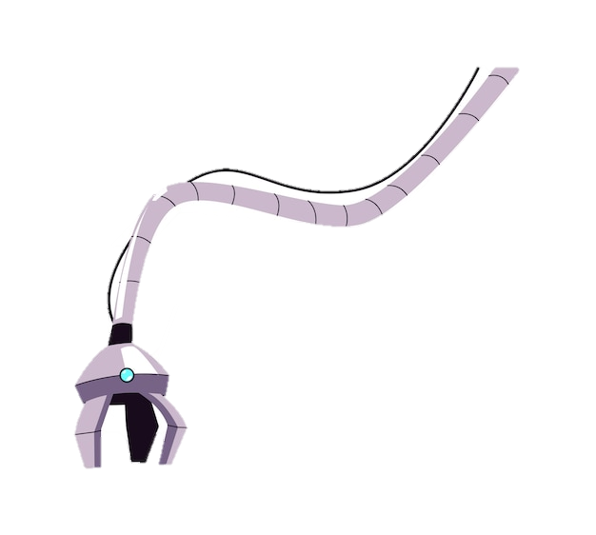
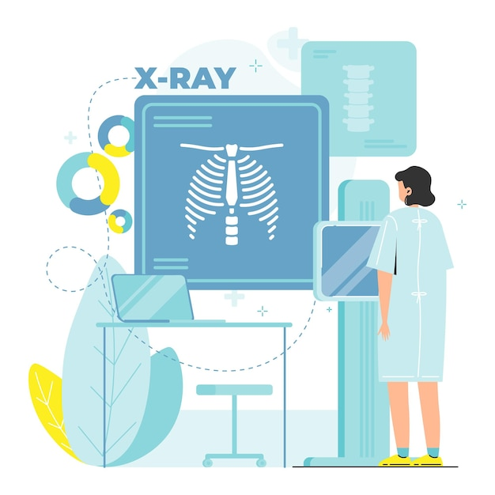
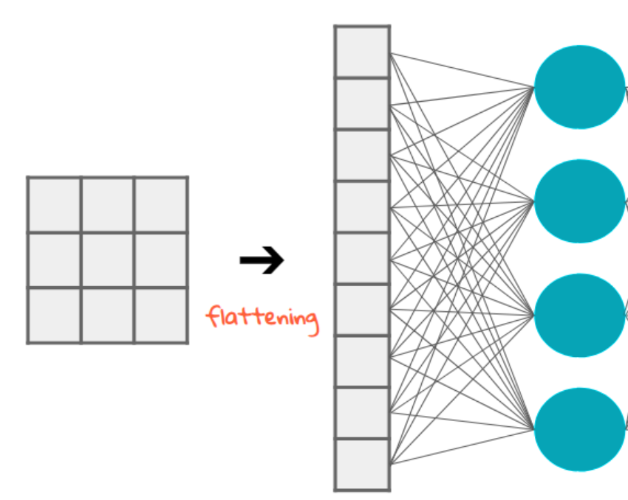
Flatten Layer:
The flatten layer converts the 2D feature maps into a 1D vector, preparing them for input into the fully connected layers.

Slide 11
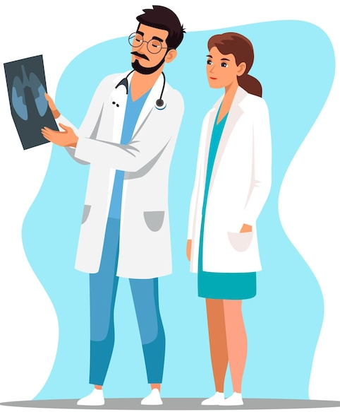
Fully Connected (Dense) Layers:
This fully connected layer introduces additional non-linearity to the model, enabling it to learn complex patterns and relationships in the data.

Slide 12

Model Architecture:
Block | Layer | Input | Filter | Stride | Activation function | Dropout
Conv1 | Conv1 | 150X150 | 7X7X32 | 1 | ReLu | -
 | Max Pool1 | 150X150X32 | 2X2 | 2 | - | -
Conv2 | Conv2 | 75X75X32 | 5X5X64 | 1 | ReLu | -
 | Max Pool2 | 75X75X64 | 2X2 | 2 | - | -
Conv3 | Conv3 | 37X37X64 | 3X3X128 | 1 | ReLu | -
 | Max Pool3 | 37X37X128 | 2X2 | 2 | - | -
 | Batch Norm | 18X18X128 | - | - | - | -
 | Flatten | 18X18X128 | - | - | - | -
Fully connected | Dense1 | 41472 | - | - | ReLu | 0.2
 | Dense2 | 32 |  |  | ReLu | 0.2
 | Dense3 | 16 | - | - | ReLu | 0.2
Output | Output | 8 | - | - | Sofmax | -

Slide 13

Training the Model:
After splitting the dataset into training and test sets (80/20), we got 956 images for training and 240 images for testing.
Loss Function → Categorical Cross-entropy : Since this is a multi-class classification problem with three classes, categorical cross-entropy is an appropriate choice for the loss function.
Optimizer → Adam : It is a popular choice for training deep learning models.

Slide 14
Training the Model:
Metrics → Accuracy : It is a commonly used evaluation metric for classification tasks. It measures the proportion of correctly classified samples out of the total number of samples. While monitoring accuracy during training, we aim to maximize it to improve the model's performance.
Batch Size → 32 : The batch size determines the number of samples processed by the model in each iteration.

Slide 15
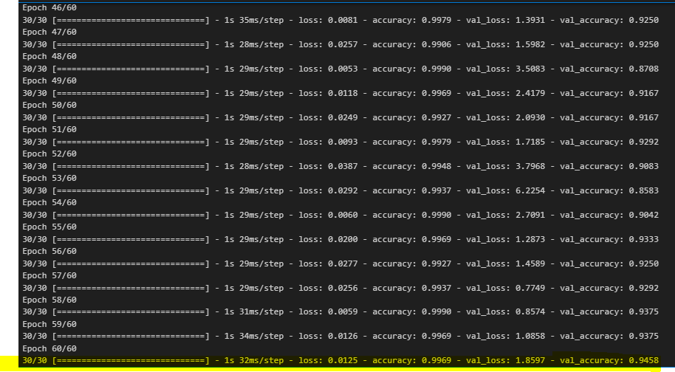

Slide 16
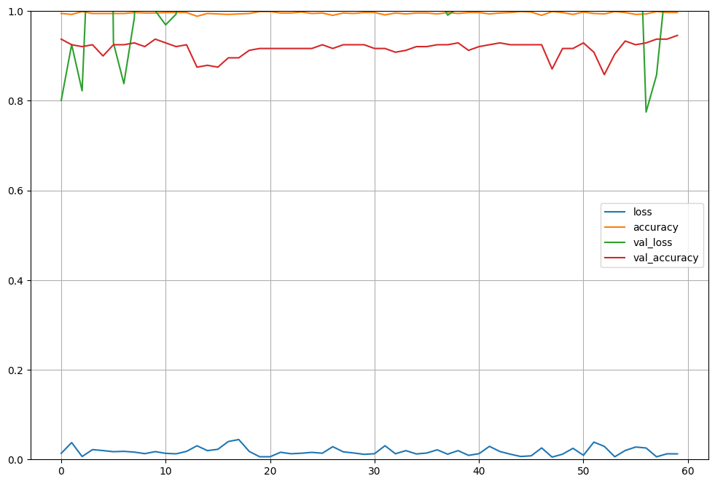
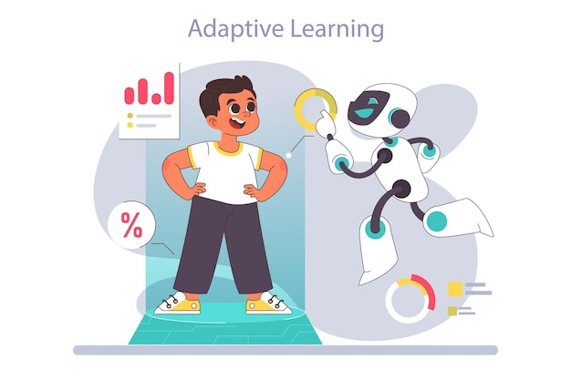
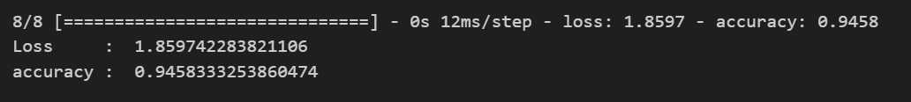
Results
This figure displays the training and validation loss/accuracy for the last 60 epochs.

Slide 17
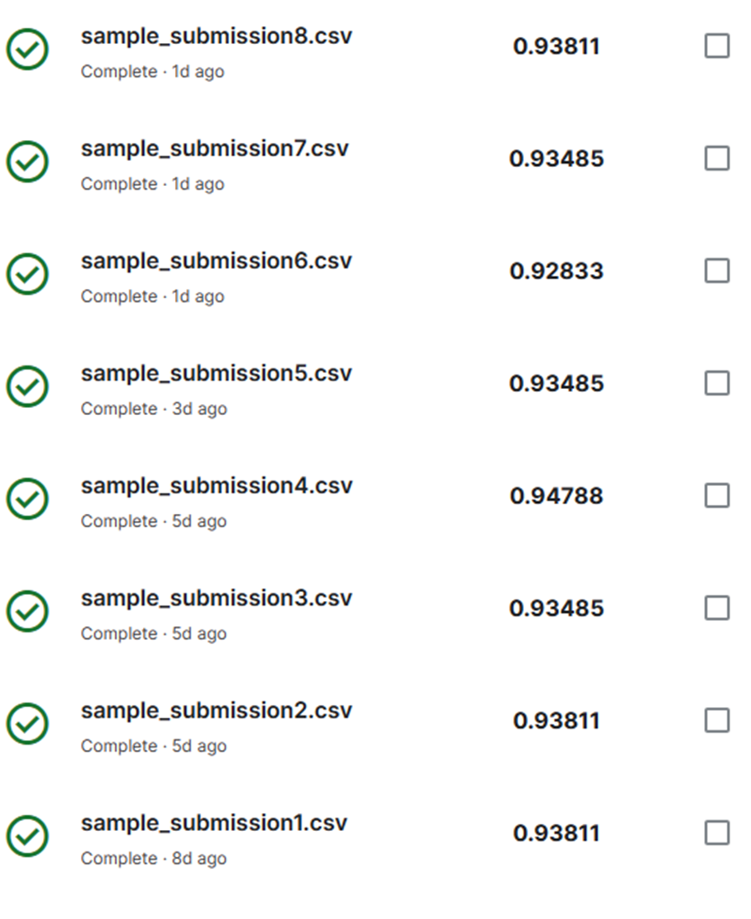

Score on Kaggle:

Slide 18
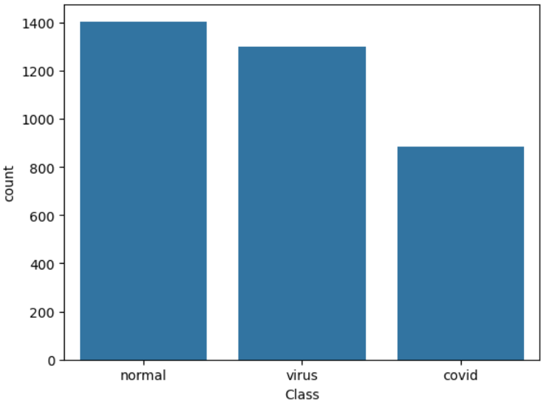
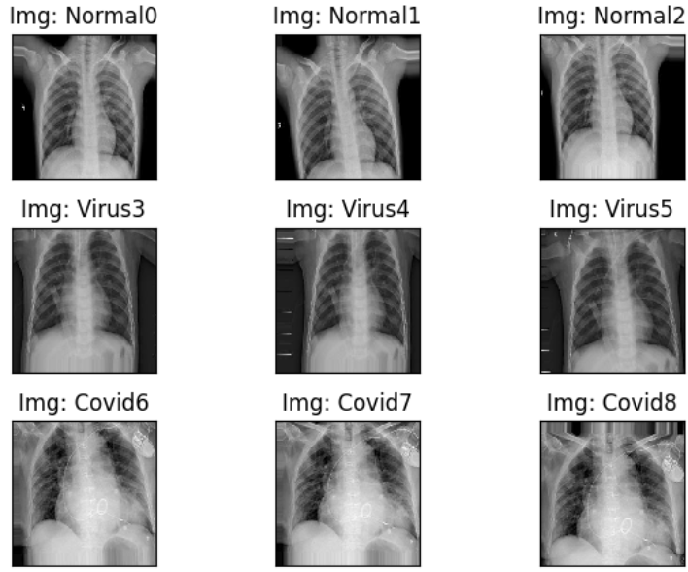
Journey of the project:
Experimentation with different hyper-parameters and model architectures.
Use of data augmentation techniques to improve the model's performance.
Reducing the model complexity while keeping high performances, for better resource usage.
Total params : 16,913,027 → 1,455,059

Slide 19

References:
Libraries:
TensorFlow: Used for building, training, and evaluating the CNN model.
Keras: Built on top of TensorFlow, used for defining and training deep learning models with ease.
NumPy: Utilized for numerical computations and data manipulation, particularly for handling image data.
Pandas: Used for data manipulation and analysis, particularly for loading and preprocessing datasets stored in CSV format.
Matplotlib: Employed for data visualization, particularly for plotting graphs and displaying images.
Seaborn: Used for statistical data visualization, particularly for creating countplots and bar charts.
Scikit-learn: Utilized for data preprocessing, evaluation metrics calculation, and train-test splitting.
Datasets:
Chest X-ray Images Dataset: The dataset consists of posteroanterior (PA) view chest X-ray images collected from various sources, comprising Normal, Viral, and COVID-19 affected patients. This dataset serves as the primary source of data for training, validating, and testing the CNN model.
Google Colab:
Google Colab was used as the development environment for writing and executing the code. It provides free access to GPUs and TPUs, enabling faster training of deep learning models.
Google Drive:
Google Drive was utilized for storing and accessing the dataset, CSV files, and trained model weights. It facilitates easy collaboration and sharing of project resources among team members.

Slide 20

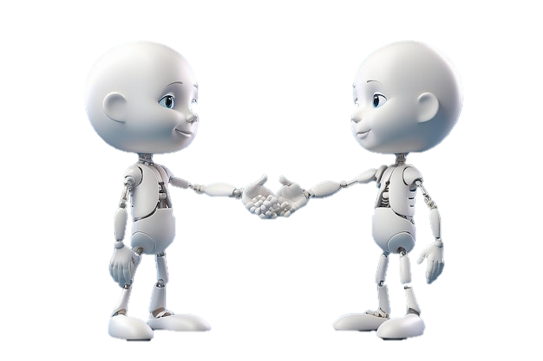
Thank you

